Slide 1

«Every patient carries her or his own doctor inside»
Albert Schweitzer

Slide 2
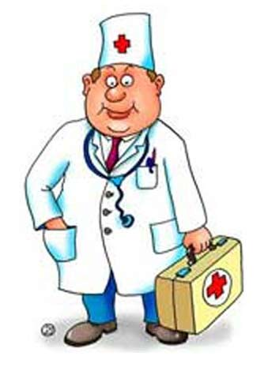
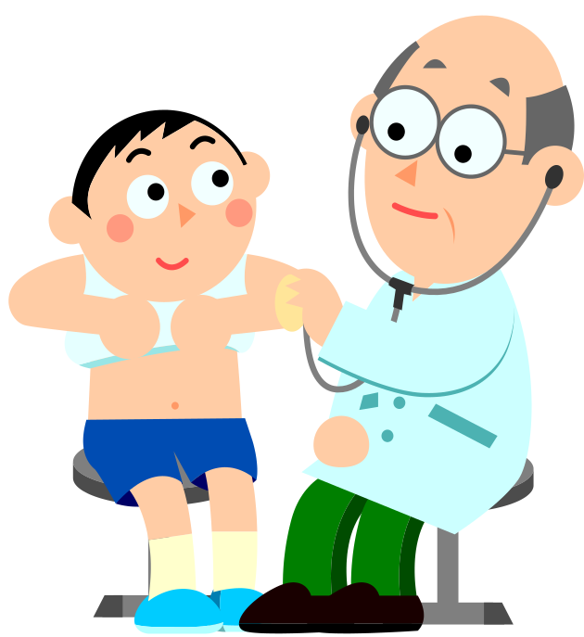
A visit to
the doctor

Slide 3
Looking back on days gone by
Sometimes it makes me want to cry
With all the things that I've been through
Sometimes I wonder if its true
With all the patients and the staff
For all the times we will cross each others path
A friendly reminder to recall
A Happy Kidney Month to one and all

Slide 4
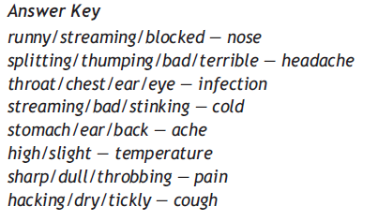

Slide 5





Slide 6
A doctor | A patient
B,C,D,E | A,F,G

Slide 7
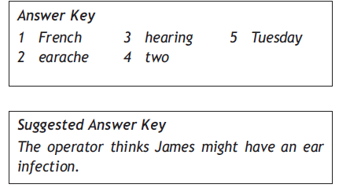

Slide 8

HOMETASK
1.To write a composition
“My Health”.

Slide 9
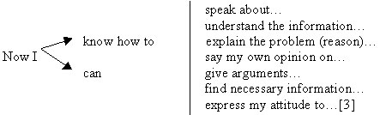

Slide 10
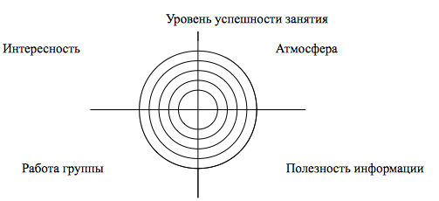
My card of success
Intersting
Atmosphere of a lesson
information’s profit (полезность информации)
My group

